Slide 1
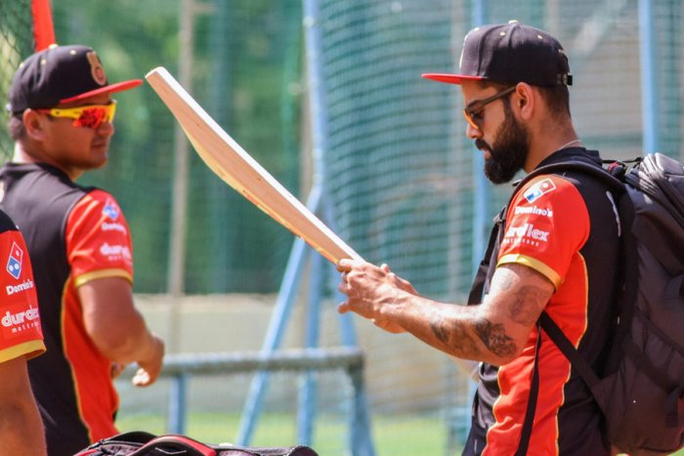
SQL
PROJECT 1
IPL DATASET

Slide 2

ER DIAGRAM
PROBLEM STATEMENT
DATABASE ANALYSIS
CONTENTS
SOLUTIONS

Slide 3
MySQL
SKILLS ENFORCED
JOINS
SUB QUERIES
AGGREGATE FUNCTIONS
TRIGGER FUNCTIONS
WINDOWS FUNCTIONS

Slide 4
IPL_User
IPL_STADIUM
IPL_Team
IPL_Player
IPL_Match_Schedule
IPL_Bidding_Details
IPL_Team_Standings
IPL_Bidder_Details
IPL_Bidder_Points
: IPL_Team_players
IPL_Tournament
IPL_Match

Slide 5
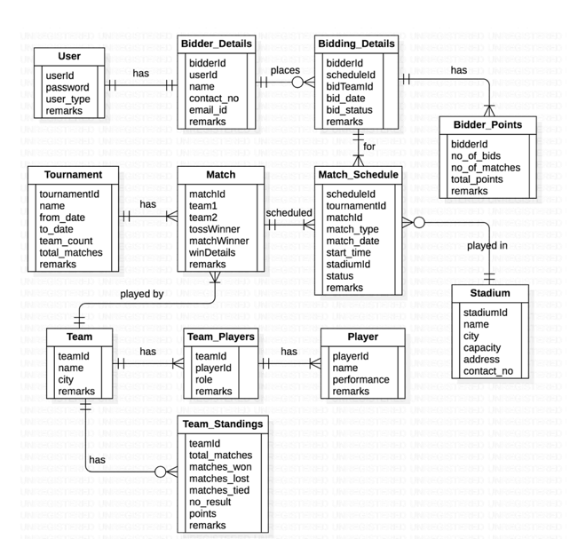
ER DIAGRAM

Slide 6

PROBLEM STATEMENT
The problem statement is to use various sql queries to find out the various insights the data set provides.
Pie-in-the-Sky
IPL Match Bidding App
Pie-in-the-Sky is a mobile app that is used for bidding for IPL matches legally. Any registered user can bid for any of the IPL matches listed in it. The app shows the match details which include the playing team, the venue of the match, and the current standing of the teams on the points table.

Slide 7
DATABASE ANALYSIS
The database is quite simple to understand since the tables are well organized and the ER diagram helps us to link one entity to another.
There are a total of 12 tables related to IPL matches , bidding, teams and their players.
We are hence required to analyse the database and come to conclusions with the outputs.

Slide 8
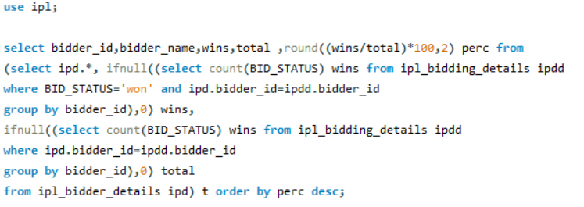


BIDDER WINS
TEAM BIDS
MATCHES

Slide 9
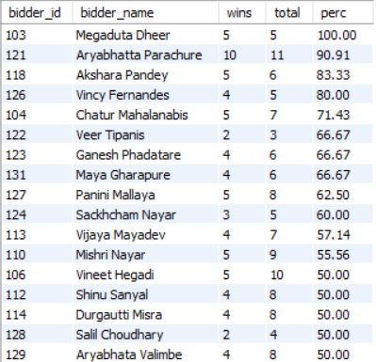
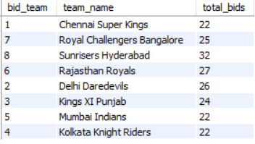
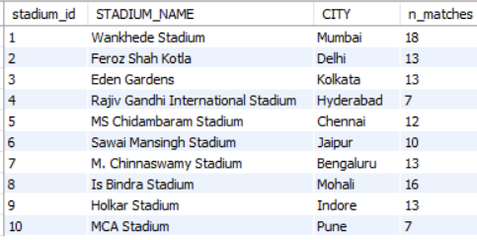
BIDDER WINS
We can see that Megaduta Dheer is at the first spot with 100% wins followed by Aryabhatta Parachure and Akshara Pandey.
TEAM BIDS
MATCHES
Sunrisers Hyderabad got the most number of bids.
Wankede stadium hosted the most number of matches, which is 18 followed by Feroz Shah Kotla and the Eden Gardens.

Slide 10
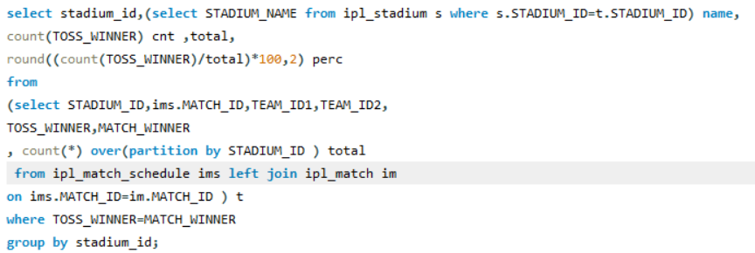
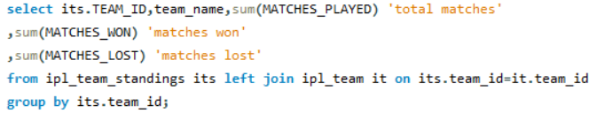
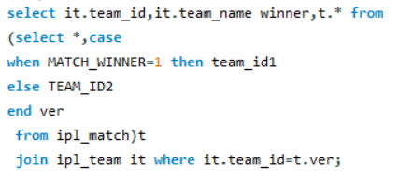
PERCENTAGE WINS OF A TEAM WHO WON THE TOSS
MATCHES WON AND LOST
MATCH WON AS PER WIN DETAILS

Slide 11
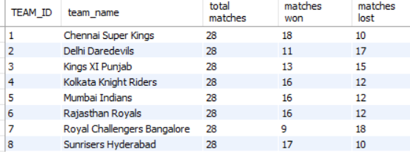
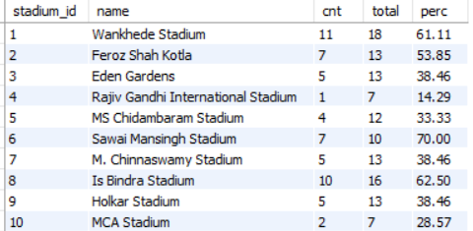
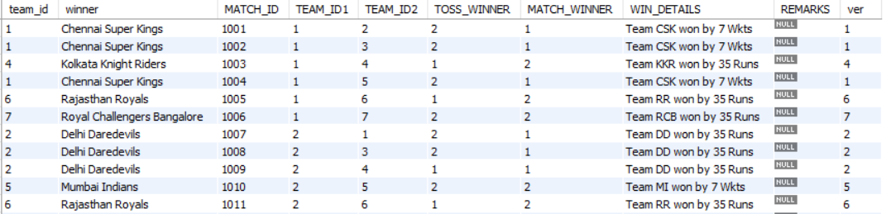
PERCENTAGE WINS OF A TEAM WHO WON THE TOSS
We can say that Wankhede Stadium has 61.11% of wins of the teams who won the toss.
We can conclude that the team who won the toss has a clear advantage over the opponent.
MATCHES WON AND LOST
MATCH WON AS PER WIN DETAILS
CSK has won the most number of matches and Royal Challengers Bangalore have lost the most number of matches
We can observe the various win details.

Slide 12
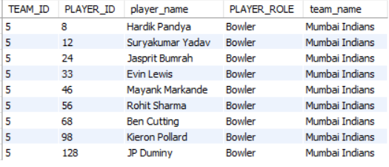

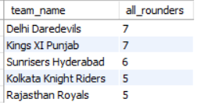
MUMBAI INDIANS BOWLERS
TEAMS WITH ALL ROUNDERS MORE THAN 4

Slide 13
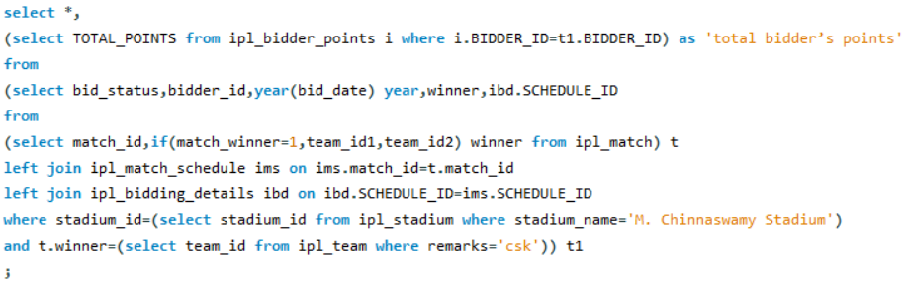
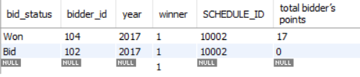
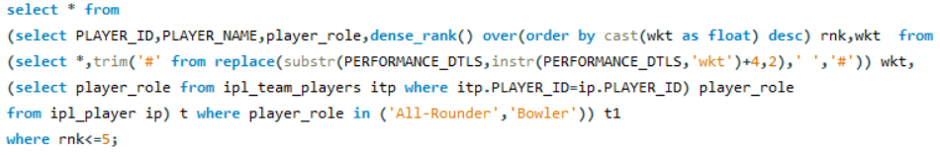
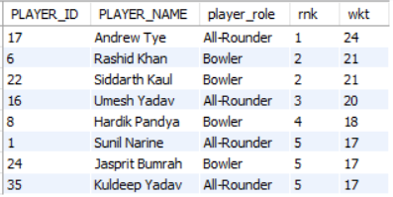
BIDDERS WHO BID ON CSK
5 HIGHEST NUMBER OF WICKETS

Slide 14
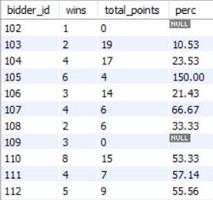
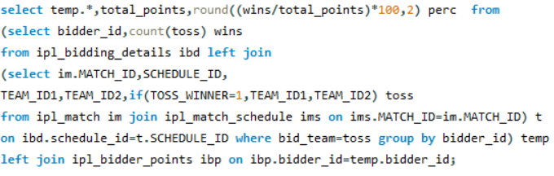
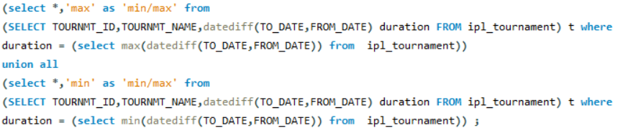

TOSS WINS OF BIDDERS
DURATION OF IPL SEASONS

Slide 15
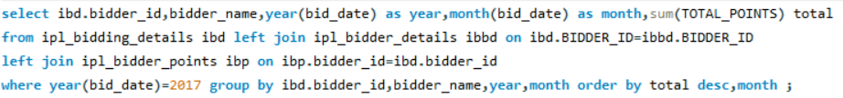
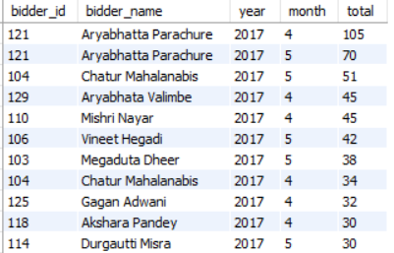
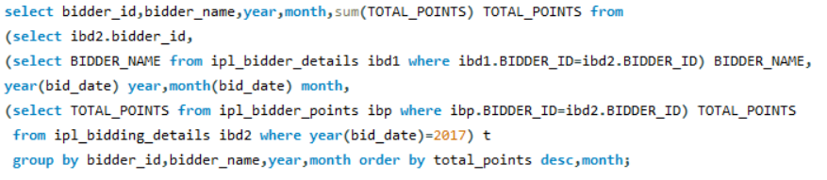
BID POINTS BY MONTH 2017
SUB QUERY

Slide 16
BID POINTS BY MONTH 2017
SUB QUERY

Slide 17
Add your
title
Here you can enter your relevant text to explain your products or services to attendees.Here you can enter your relevant text to explain your products or services to attendees.Here you can enter your relevant text to explain your products or services to attendees.Here you can enter your relevant text to explain your products or services to attendees.Here you can enter your relevant text to explain your products or services to attendees.Here you can enter your relevant text to explain your products or services to attendees.
Add your text
2
4
Here you can enter your relevant text to explain your products or services to attendees.
Add your text
Add your text
1
3
Here you can enter your relevant text to explain your products or services to attendees.
Here you can enter your relevant text to explain your products or services to attendees.
Add your text

Slide 18
Add your company
Add your website
THANKS

